Slide 1
Processing Data Streams: Motivation
A growing number of applications generate streams of data
  Performance measurements in network monitoring and traffic management
  Call detail records in telecommunications
  Transactions in retail chains, ATM operations in banks
  Log records generated by Web Servers
  Sensor network data
Application characteristics
  Massive volumes of data (several terabytes)
  Records arrive at a rapid rate
Goal: Mine patterns, process queries and compute statistics on data streams in real-time

Slide 2
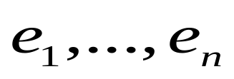
Data Streams: Computation Model
A data stream is a (massive) sequence of elements:
Stream processing requirements
  Single pass: Each record is examined at most once
  Bounded storage: Limited Memory (M) for storing synopsis
  Real-time: Per record processing time (to maintain synopsis) must be low
Synopsis in Memory
Data Streams
Stream
Processing
Engine
(Approximate)
Answer

Slide 3


Data Stream Processing Algorithms
Generally, algorithms compute approximate answers
  Difficult to compute answers accurately with limited memory
Approximate answers - Deterministic bounds
  Algorithms only compute an approximate answer, but bounds on error
Approximate answers - Probabilistic bounds
  Algorithms compute an approximate answer with high probability
    With probability at least , the computed answer is within a factor of the actual answer
Single-pass algorithms for processing streams also applicable to (massive) terabyte databases!

Slide 4
Sampling: Basics
Idea: A small random sample S of the data often well-represents all the data
  For a fast approx answer, apply “modified” query to S
  Example: select agg from R where R.e is odd
  (n=12)
  If agg is avg, return average of odd elements in S
  If agg is count, return average over all elements e in S of
    n if e is odd
    0 if e is even
Data stream: 9 3 5 2 7 1 6 5 8 4 9 1
Sample S: 9 5 1 8
answer: 5
answer: 12*3/4 =9
Unbiased: For expressions involving count, sum, avg: the estimator
is unbiased, i.e., the expected value of the answer is the actual answer

Slide 5
Probabilistic Guarantees
Example: Actual answer is within 5 ± 1 with prob ≥ 0.9
Use Tail Inequalities to give probabilistic bounds on returned answer
  Markov Inequality
  Chebyshev’s Inequality
  Hoeffding’s Inequality
  Chernoff Bound

Slide 6



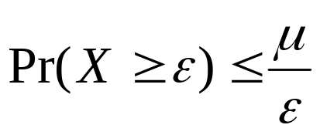
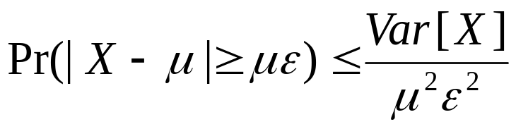
Tail Inequalities
General bounds on tail probability of a random variable (that is, probability that a random variable deviates far from its expectation)
Basic Inequalities: Let X be a random variable with expectation and variance Var[X]. Then for any
Probability
distribution
Tail probability
Markov:
Chebyshev:

Slide 7
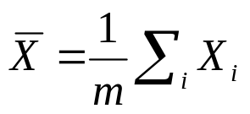

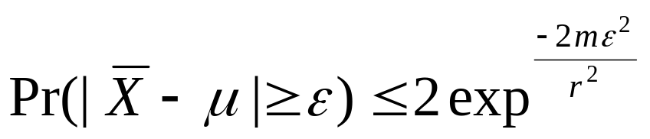
Tail Inequalities for Sums
Possible to derive stronger bounds on tail probabilities for the sum of independent random variables
Hoeffding’s Inequality: Let X1, ..., Xm be independent random variables with 0<=Xi <= r. Let and be the expectation of . Then, for any
Application to avg queries:
  m is size of subset of sample S satisfying predicate (3 in example)
  r is range of element values in sample (8 in example)

Slide 8



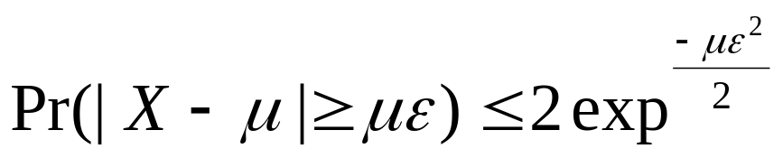
Tail Inequalities for Sums (Contd.)
Possible to derive even stronger bounds on tail probabilities for the sum of independent Bernoulli trials
Chernoff Bound: Let X1, ..., Xm be independent Bernoulli trials such that Pr[Xi=1] = p (Pr[Xi=0] = 1-p). Let and be the expectation of . Then, for any ,
Application to count queries:
  m is size of sample S (4 in example)
  p is fraction of odd elements in stream (2/3 in example)
Remark: Chernoff bound results in tighter bounds for count queries compared to Hoeffding’s inequality

Slide 9
Computing Stream Sample
Reservoir Sampling [Vit85]: Maintains a sample S of a fixed-size M
  Add each new element to S with probability M/n, where n is the current number of stream elements
  If add an element, evict a random element from S
  Instead of flipping a coin for each element, determine the number of elements to skip before the next to be added to S
Concise sampling [GM98]: Duplicates in sample S stored as <value, count> pairs (thus, potentially boosting actual sample size)
  Add each new element to S with probability 1/T (simply increment count if element already in S)
  If sample size exceeds M
    Select new threshold T’ > T
    Evict each element (decrement count) from S with probability 1-T/T’
  Add subsequent elements to S with probability 1/T’

Slide 10
Streaming Model: Special Cases
Time-Series Model
  Only j-th update updates A[j] (i.e., A[j] := c[j])
Cash-Register Model
  c[j] is always >= 0 (i.e., increment-only)
  Typically, c[j]=1, so we see a multi-set of items in one pass
Turnstile Model
  Most general streaming model
  c[j] can be >0 or <0 (i.e., increment or decrement)
Problem difficulty varies depending on the model
  E.g., MIN/MAX in Time-Series vs. Turnstile!

Slide 11
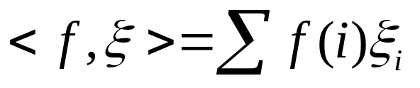


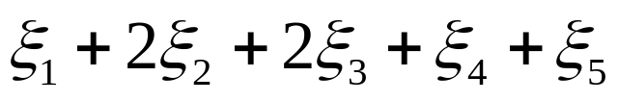
Linear-Projection (aka AMS) Sketch Synopses
Goal: Build small-space summary for distribution vector f(i) (i=1,..., N) seen as a stream of i-values
Basic Construct: Randomized Linear Projection of f() = project onto inner/dot product of f-vector
  Simple to compute over the stream: Add whenever the i-th value is seen
  Generate ‘s in small (logN) space using pseudo-random generators
  Tunable probabilistic guarantees on approximation error
  Delete-Proof: Just subtract to delete an i-th value occurrence
  Composable: Simply add independently-built projections
2
2
1
1
1
Data stream: 3, 1, 2, 4, 2, 3, 5, . . .
f(1) f(2) f(3) f(4) f(5)
where = vector of random values from an appropriate distribution
Data stream: 3, 1, 2, 4, 2, 3, 5, . . .

Slide 12


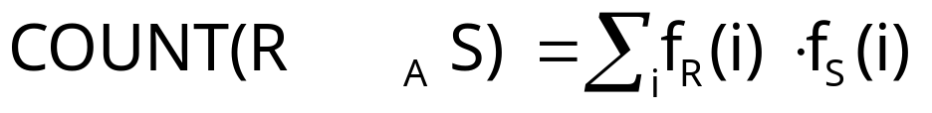
Example: Binary-Join COUNT Query
Problem: Compute answer for the query COUNT(R _{A} S)
Example:
3
2
Data stream R.A: 4 1 2 4 1 4
1
0
1
2
3
4
2
2
Data stream S.A: 3 1 2 4 2 4
1
1
1
2
3
4
= 10 (2 + 2 + 0 + 6)
Exact solution: too expensive, requires O(N) space!
  N = sizeof(domain(A))

Slide 13


Basic AMS Sketching Technique [AMS96]
Key Intuition: Use randomized linear projections of f() to define random variable X such that
  X is easily computed over the stream (in small space)
  E[X] = COUNT(R _{A} S)
  Var[X] is small
Basic Idea:
  Define a family of 4-wise independent {-1, +1} random variables
  Pr[ = +1] = Pr[ = -1] = 1/2
    Expected value of each , E[ ] = 0
  Variables are 4-wise independent
    Expected value of product of 4 distinct = 0
  Variables can be generated using pseudo-random generator using only O(log N) space (for seeding)!
Probabilistic error guarantees
(e.g., actual answer is 10±1 with
probability 0.9)

Slide 14
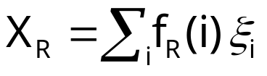
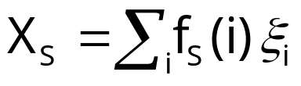




AMS Sketch Construction
Compute random variables: and
  Simply add to X_{R}(X_{S}) whenever the i-th value is observed in the R.A (S.A) stream
Define X = X_{R}X_{S} to be estimate of COUNT query
Example:
3
2
Data stream R.A: 4 1 2 4 1 4
1
0
1
2
3
4
2
2
Data stream S.A: 3 1 2 4 2 4
1
1
1
2
3
4

Slide 15

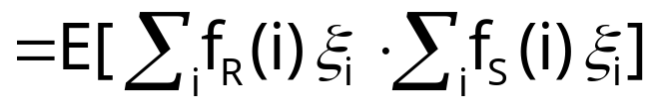
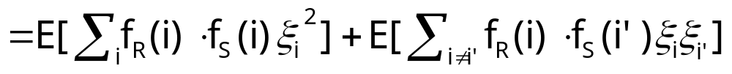
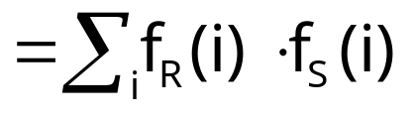


Binary-Join AMS Sketching Analysis
Expected value of X = COUNT(R _{A} S)
Using 4-wise independence, possible to show that
is self-join size of R (second/L2 moment)
1
0

Slide 16
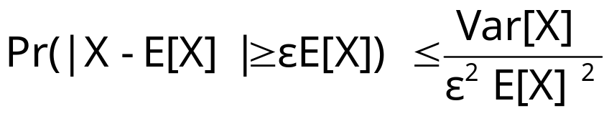

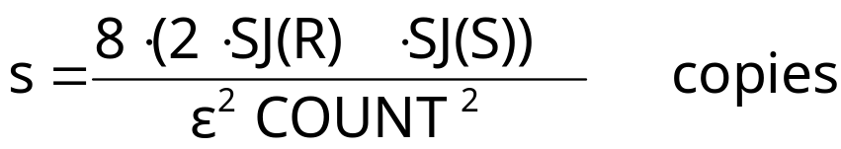

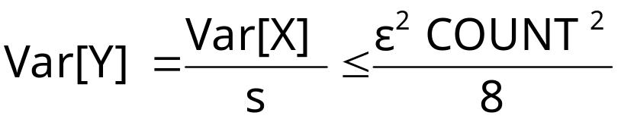
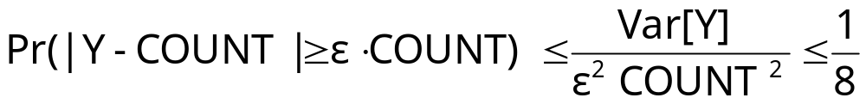
Boosting Accuracy
Chebyshev’s Inequality:
Boost accuracy to by averaging over several independent copies of X (reduces variance)
By Chebyshev:
x
x
x
Average
y

Slide 17










Boosting Confidence
Boost confidence to by taking median of 2log(1/ ) independent copies of Y
Each Y = Bernoulli Trial
“FAILURE”:
y
2log(1/ )
copies
y
median
y
Pr[|median(Y)-COUNT| COUNT]
= Pr[ # failures in 2log(1/ ) trials >= log(1/ ) ]
(By Chernoff Bound)

Slide 18
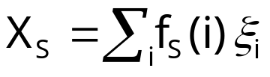
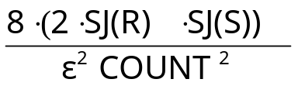



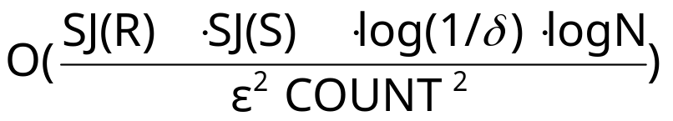
Summary of Binary-Join AMS Sketching
Step 1: Compute random variables: and
Step 2: Define X= X_{R}X_{S}
Steps 3 & 4: Average independent copies of X; Return median of averages
Main Theorem (AGMS99): Sketching approximates COUNT to within a relative error of with probability using space
  Remember: O(log N) space for “seeding” the construction of each X
copies
x
x
x
Average
y
2log(1/ )
copies
x
x
x
Average
y
median
x
x
x
Average
y

Slide 19
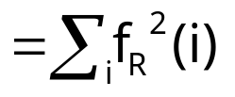
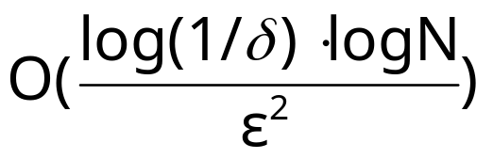
A Special Case: Self-join Size
Estimate COUNT(R A R) (original AMS paper)
Second (L2) moment of data distribution, Gini index of heterogeneity, measure of skew in the data
In this case, COUNT = SJ(R), so we get an (ε,δ)−estimate using space only
Best-case for AMS streaming join-size estimation

Slide 20

Distinct Value Estimation
Problem: Find the number of distinct values in a stream of values with domain [0,...,N-1]
  Zeroth frequency moment , L0 (Hamming) stream norm
  Statistics: number of species or classes in a population
  Important for query optimizers
  Network monitoring: distinct destination IP addresses, source/destination pairs, requested URLs, etc.
Example (N=64)
Data stream: 3 0 5 3 0 1 7 5 1 0 3 7
Number of distinct values: 5

Slide 21
Hash (aka FM) Sketches for Distinct Value Estimation [FM85]
Assume a hash function h(x) that maps incoming values x in [0,…, N-1] uniformly across [0,…, 2^L-1], where L = O(logN)
Let lsb(y) denote the position of the least-significant 1 bit in the binary representation of y
  A value x is mapped to lsb(h(x))
Maintain Hash Sketch = BITMAP array of L bits, initialized to 0
  For each incoming value x, set BITMAP[ lsb(h(x)) ] = 1
BITMAP
5 4 3 2 1 0
x = 5
h(x) = 101100
lsb(h(x)) = 2
0
0
0
1
0
0

Slide 22
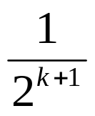

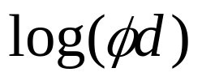

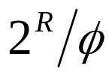
Hash (aka FM) Sketches for Distinct Value Estimation [FM85]
By uniformity through h(x): Prob[ BITMAP[k]=1 ] = Prob[ ] =
  Assuming d distinct values: expect d/2 to map to BITMAP[0] , d/4 to map to BITMAP[1], . . .
Let R = position of rightmost zero in BITMAP
  Use as indicator of log(d)
[FM85] prove that E[R] = , where
  Estimate d =
  Average several iid instances (different hash functions) to reduce estimator variance
BITMAP
L-1
0
0
0
0
0
0
0
1
0
1
0
1
1
1
1
1
1
1
1
fringe of 0/1s around log(d)
position >> log(d)
position << log(d)

Slide 23



Hash Sketches for Distinct Value Estimation
[FM85] assume “ideal” hash functions h(x) (N-wise independence)
  [AMS96]: pairwise independence is sufficient
    h(x) = , where a, b are random binary vectors in [0,…,2^L-1]
  Small-space estimates for distinct values proposed based on FM ideas
Delete-Proof: Just use counters instead of bits in the sketch locations
  +1 for inserts, -1 for deletes
Composable: Component-wise OR/add distributed sketches together
  Estimate |S1 S2 … Sk| = set-union cardinality

Slide 24
The CountMin (CM) Sketch
Simple sketch idea, can be used for point queries, range queries, quantiles, join size estimation
Model input at each node as a vector x_{i} of dimension N, where N is large
Creates a small summary as an array of w ╳ d in size
Use d hash functions to map vector entries to [1..w]
W
d

Slide 25
CM Sketch Structure
+x_{i}[j]
h₁(j)
j,x_{i}[j]
+x_{i}[j]
d
+x_{i}[j]
h_{d}(j)
+x_{i}[j]
w
Each entry in vector A is mapped to one bucket per row
Merge two sketches by entry-wise summation
Estimate A[j] by taking min_{k} sketch[k,h_{k}(j)]
[Cormode, Muthukrishnan ’05]

Slide 26
CM Sketch Summary
CM sketch guarantees approximation error on point queries less than ε||A||₁ in size O(1/ε log 1/δ)
  Probability of more error is less than 1-δ
  Similar guarantees for range queries, quantiles, join size
Hints
  Counts are biased! Can you limit the expected amount of extra “mass” at each bucket? (Use Markov)
  Use Chernoff to boost the confidence for the min{} estimate
Food for thought: How do the CM sketch guarantees compare to AMS??

